Slide 1

Agile/Scrum Development Process Joseph Silva SNHU Software Development Life Cycle CS-250 Professor: Ryan Woolever 12/15/2024
This Photo by Unknown Author is licensed under CC BY-NC-ND

Slide 2

Agenda
Agile/Scrum team roles
Agile development phases
Waterfall development process
Differences between agile and waterfall

Slide 3

Agile/Scrum Team Roles
This Photo by Unknown Author is licensed under CC BY

Slide 4
Product Owner
The product owner is responsible for creating and managing the product backlog for the scrum team in a clear and transparent way (Cobb, 2015).
The product owner works with end users and stakeholders and communicates product related expectations to the scrum team.
The product owner is the decision maker when it comes to the product backlog and sets the priority for the work (Cobb, 2015).
Facilitates the “sprint review” meeting and “backlog refinement” activity.

Slide 5
Scrum Master
The scrum 9master is responsible for making sure the team follows the agile framework (Cobb, 2015).
The scrum master sets up and facilitates the below scrum events:
Sprint planning (lead the estimation process)
Daily standup
Sprint retrospective
Starts and stops sprints
The Scrum master works to remove impediments within the scrum team.
The Scrum master can act as a coach for the team and organization during agile adoption (Cobb, 2015).

Slide 6
Developer/Testing Specialist
All members of an agile team are known as developers including the testing specialists.
The developers are a self organizing team that is expected to manage their own work (Cobb, 2015).
The developers should be a cross functional team with a diverse skill set (Cobb, 2015).
The development team is ultimately responsible for creating the product increment (Cobb, 2015).
While the development team may include a testing specialist, the quality of the product is the responsibility of the entire team and not just the tester.
Developers take advantage of knowledge sharing so all team members can work on open tasks even when they are outside their area of expertise.

Slide 7
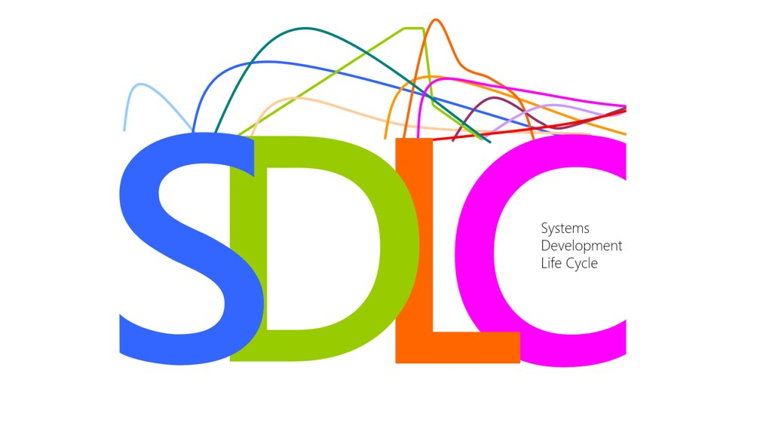
Agile Phases
This Photo by Unknown Author is licensed under CC BY

Slide 8
Agile Development Phases
Concept - This is the initial phase:
Product owner determines the scope of the project (Zhezherau, A. (n.d.)).
Product owner gathers feature requirements with clients (Zhezherau, A. (n.d.)).
Inception - The second phase:
The scrum team is created (Zhezherau, A. (n.d.)).
The design process is started (Zhezherau, A. (n.d.)).
The product owner should have regular check ins with the client to ensure the correct requirements are built into the design.
Iteration - Phase where a small increment of work is complete:
Longest phase of the process where the bulk is the work is done (Zhezherau, A. (n.d.):.
This is where the team turns the design into code (Zhezherau, A. (n.d.)).
The goal is to have the bare functionality available at the end of the iteration ((Zhezherau, A. (n.d.)).
Additional feature development can occur in future iterations (Zhezherau, A. (n.d.)).

Slide 9
Agile Development Phases
Release/Testing - Software packaged for release and validated:
Quality assurance runs some testing to verify the software is fully functional (Zhezherau, A. (n.d.)).
The scrum team also tests the software in search of code bugs (Zhezherau, A. (n.d.)).
User training will take place and documented (Zhezherau, A. (n.d.):.
Once complete, the software can be released to production (Zhezherau, A. (n.d.)).
Maintenance – Monitor for defects:
Software is fully deployed and available for the customer (Zhezherau, A. (n.d.)):.
The development team is available to make sure the system runs smoothly and to resolve any new bugs quickly (Zhezherau, A. (n.d.)).
User training continues (Zhezherau, A. (n.d.)).
Retirement - Software obsolete:
User notified that the software is being retired and urged to migrate if a newer release is available (Zhezherau, A. (n.d.)).

Slide 10

Waterfall Development Process

Slide 11
Waterfall Development Process
The waterfall development process is a structured sequential approach to software development (GeeksForGeeks, 2024).
Extensive documentation is created up front (GeeksForGeeks, 2024).
Code is developed and unit tested before going through more rigorous testing:
This leaves the software vulnerable to late breaking bugs and being released with known defects due to constant code churn and short testing runway.
The waterfall method is not very flexible:
Late requirement changes could result in extensive code refactoring and more testing which leads to higher cost and more risk to the product.
Quality can also be compromised due to late requests for code changes.

Slide 12
Waterfall Development Process
What would have been different if we had used the waterfall method for the SNHU travel project?
A much longer planning cycle would have been needed.
Developers would get assigned features and work siloed instead of on a team in constant communication.
End users and stakeholders wouldn’t see the software until it was fully developed.
Implementing code changes at the end of the development cycle would have been more difficult, costly and risky.
Product could potentially be released with known defects due to the risk of adding bug fixes late in the process that could result in unknown side effects.

Slide 13
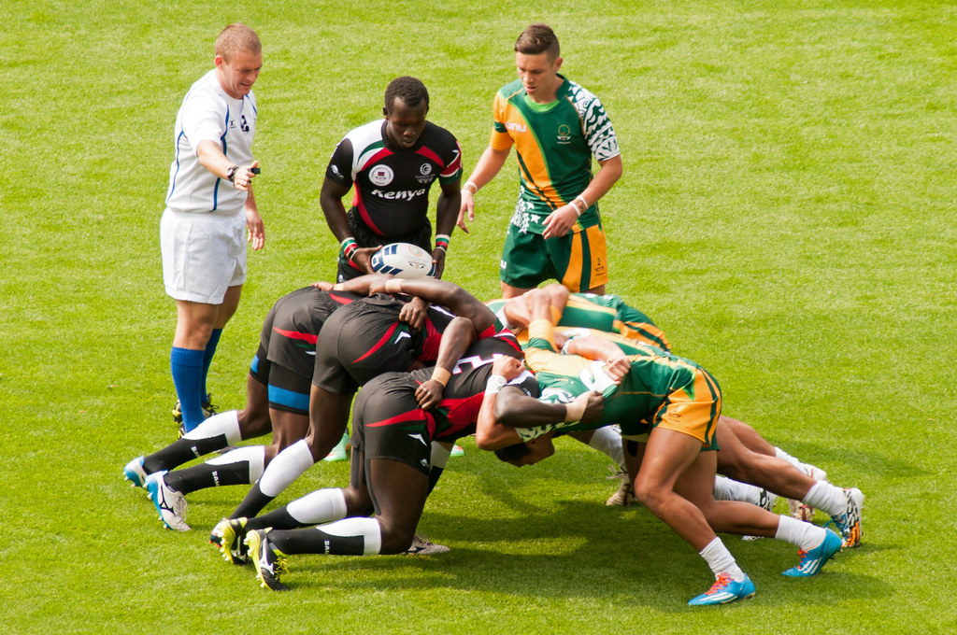
Agile/Scrum or Waterfall
This Photo by Unknown Author is licensed under CC BY-SA-NC

Slide 14
Agile/Scrum or Waterfall
When should I choose Waterfall or Agile/Scrum?
Waterfall:
When working on projects that will remain static (Scrum alliance, (n.d.)).
Projects with compliance requirements like the predictability and checkpoints of waterfall (Scrum alliance, (n.d)).
When extensive documentation and planning is required.
Agile/Scrum:
When flexibility is needed due to potentially changing requirements.
When shorter iterations of releases are desired.
The tech marketplace, which would include the SNHU travel website, is ideal for agile/scrum due to rapid evolution (Scrum alliance, (n.d.)).

Slide 15
References
Cobb, C. G. (2015). The project manager's guide to mastering agile: Principles and practices for an adaptive approach. Wiley.
GeeksforGeeks. (2024, October 18). Waterfall model – Software engineering.
Retrieved from https://www.geeksforgeeks.org/waterfall-model/

Slide 16
References Cont.
Scrum Alliance. (n.d.). Scrum vs. waterfall.
Retrieved from https://resources.scrumalliance.org/article/scrum-vs-waterfall
Zhezherau, A. (n.d.). The agile software development life cycle.
Retrieved from https://www.wrike.com/insights/the-agile-software-development-life-cycle

Slide 17

Thank You!!

